Slide 1
Datacrowd
Final Presentation TEAM 01
Tsampras Konstantinos Papoutsas Georgios

Slide 2




Mission Statement
Crowd Monitoring in Public Spaces
Problems:
Overcrowding
Disease Transmission Risk [Hospitals, Public Spaces]
Air Quality Considerations [Closed areas, Shops etc.]
Personal Scheduling
Avoid High Traffic Hours or Spaces
Visit recreational spaces during peak popularity
Convoluted Personal Time Schedules
Resource Management
Ineffective Employee timetables
Public Transport Dispatching
Marketing in Public Spaces

Slide 3
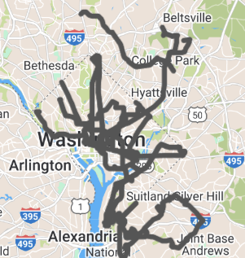
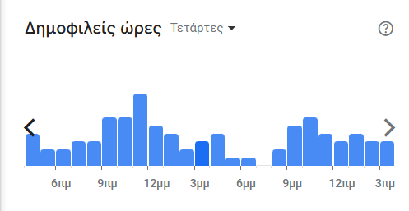
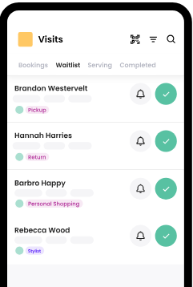
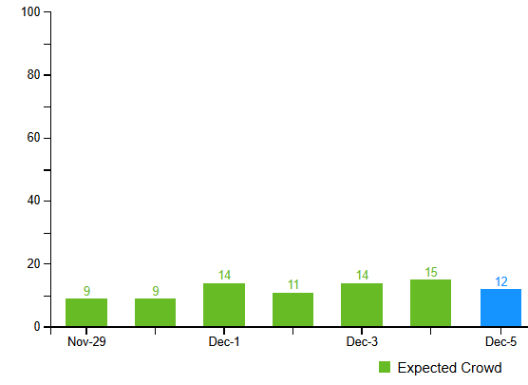
Other solutions
Features/App | Public Transit apps | Avoid crowds | Waitwhile | Google Places API | Foursquare | Datacrowd
Crowd Prediction |  | X | X | X | X | X
Multi-source model |  |  |  |  |  | X
Business & Authorities Insights |  |  | X | X | X | X
Commute Scheduling | X |  |  | X | X | X
https://www.wmata.com/service/status/
https://avoid-crowds.com/
https://waitwhile.com/
https://developers.google.com/maps/documentation/places/web-service
https://foursquare.com/

Slide 4

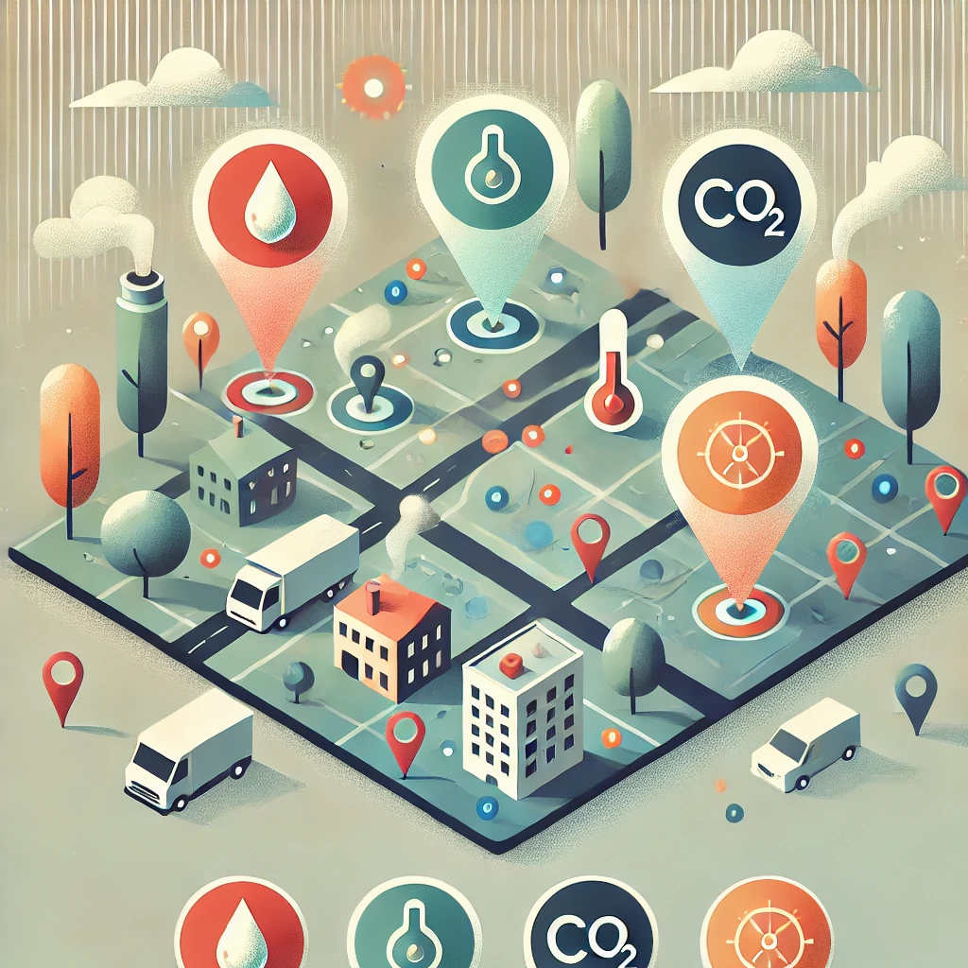

Data sources
Collect data from:
Traffic in public networks (WiFi4EU, Eduroam)
Environmental sensors (CO₂, Temperature, Humidity)
Google places API
Web Scraping Google Maps

Slide 5
Requirements
Target audience
Access to traffic in public networks
Access to the Places API
Sensors (CO₂, Temperature, Humidity) - 169€
Raspberry Pi - 70€
Citizens
Students
Users of Public Transport and Services
Tourists
Authorities and Businesses
Educational Institutions
Municipal Authorities
Private Businesses
Groups of Businesses
https://developers.google.com/maps/documentation/places/web-service/overview
https://mclimate.eu/products/mclimate-co2-sensor-notifier-lorawan?variant=47859023806796
https://www.skroutz.gr/s/19212716/Raspberry-Pi-4-Model-B-4GB.html

Slide 6
Features Overview
Inform Public for better decision making
- Real time data and Predictions [heatmaps]
- Suggestions and Alerts
Commuting citizens using Public Transport
Monitoring Tools for Authorities & Businesses
- Crowd Overview [heatmaps, graphs]
- Insights for better resource allocation
- Alerting and notifying
Staff scheduling, Efficient police force management, Bus schedule changes
Unique value proposition
- By using 3 data sources, we can analyze and combine the sources in order to create a single crowd predicting model that can provide real-time and more accurate heatmaps about the actual congestion in popular areas.

Slide 7
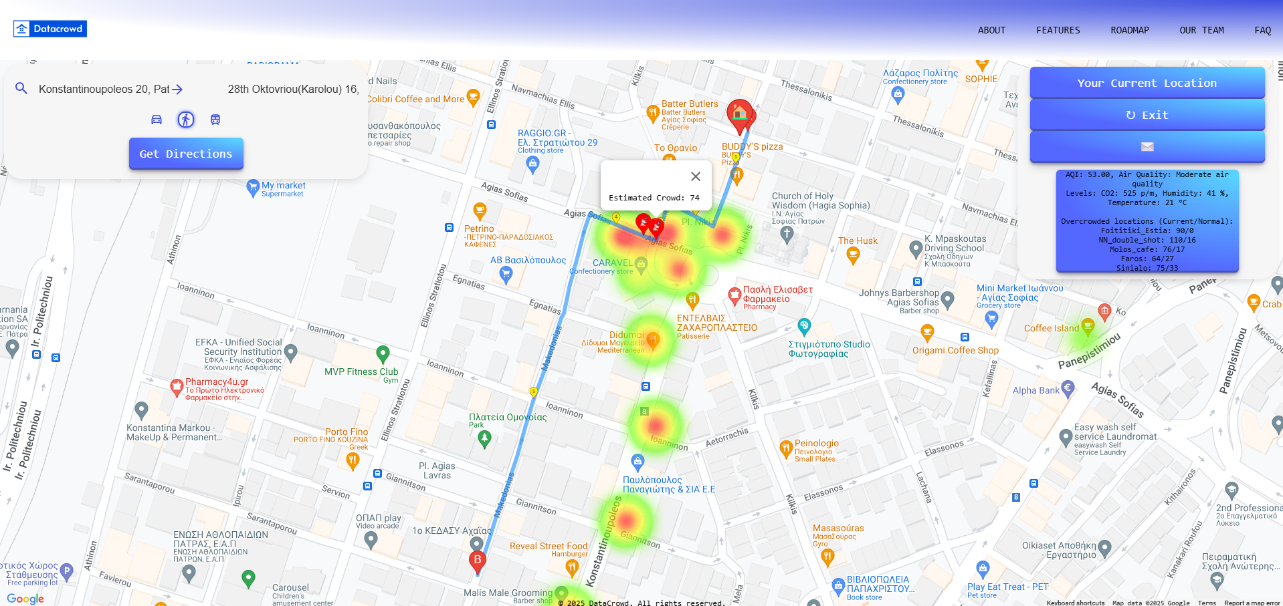
Citizens

Slide 8
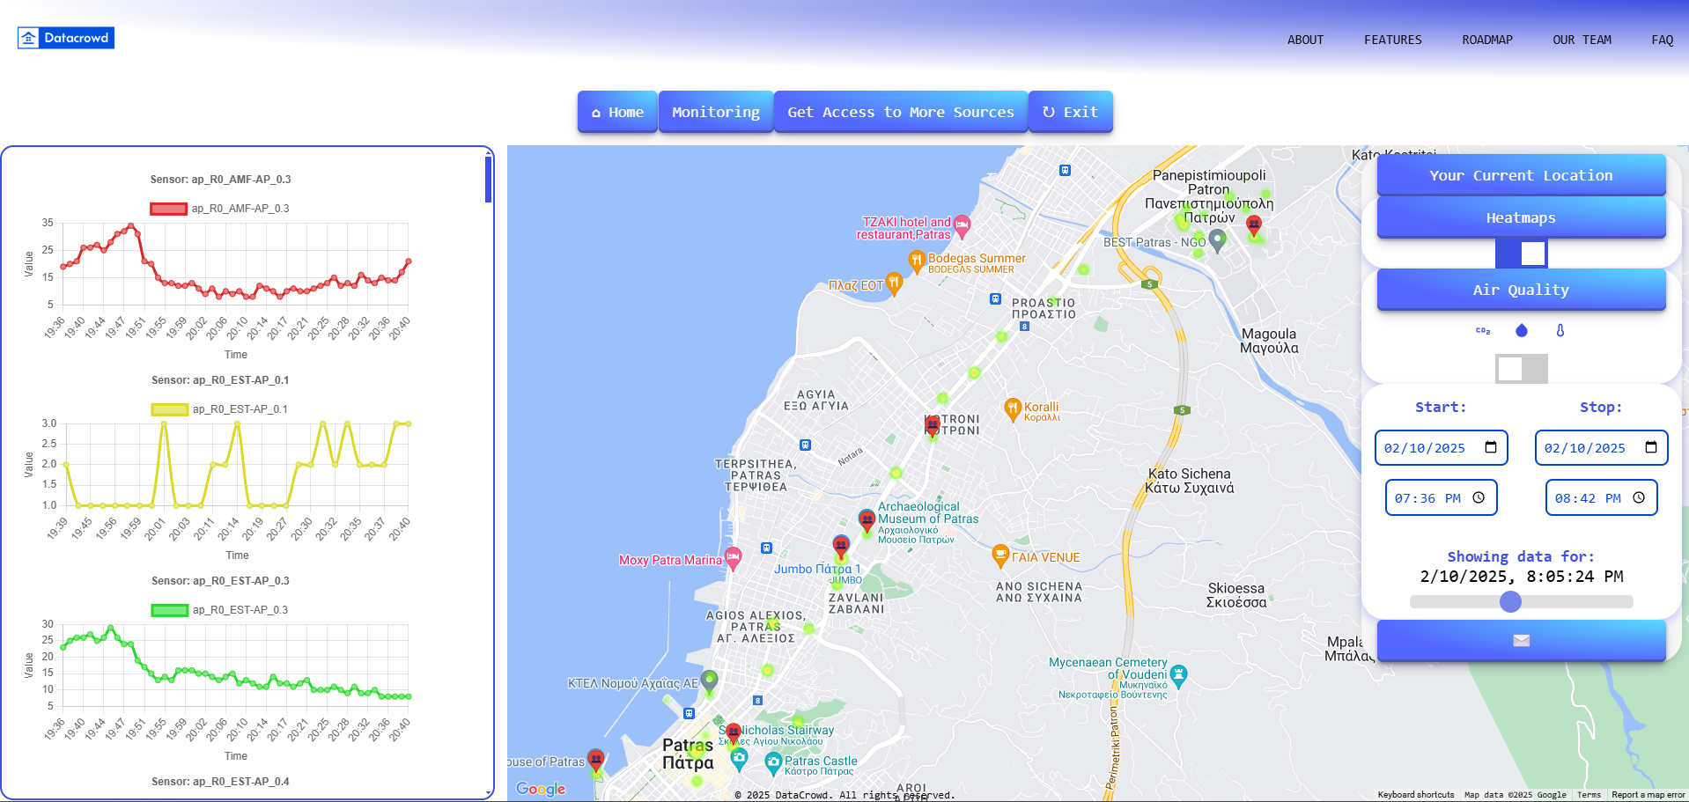
Businesses and Authorities
Notes:
Access Points Readings indicating Crowd Density
and Co2 levels translated into Crowd Density

Slide 9
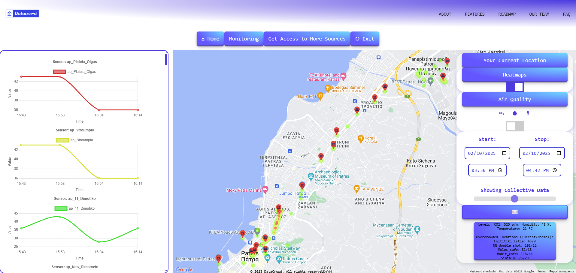
Monitoring

Slide 10
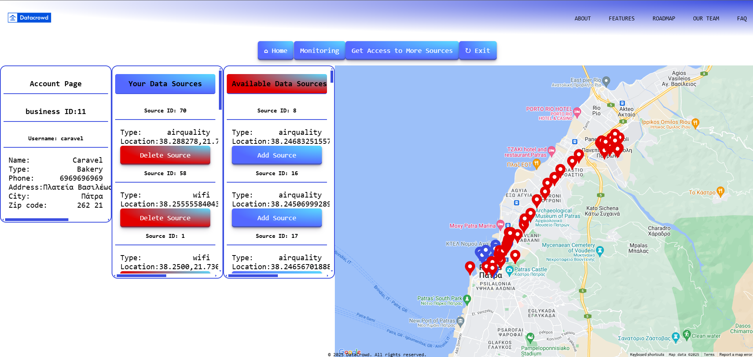
Owned Data Sources

Slide 11
Data processing
The sensor data needs to be organized and processed.
The access point traffic data will be used to estimate the number of people connected to the Local Area Network.
The climate data (CO₂, Temperature, Humidity) will be used to determine the rough size of the crowd in a closed space.
Live and historic data from Web Scraping Google Maps will be used for live and predictive crowd estimations.

Slide 12
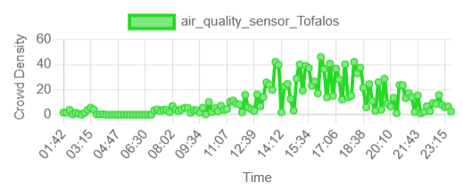
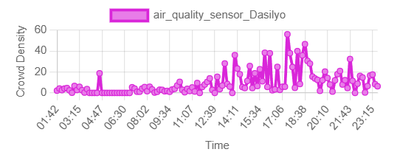
Fake Data Generation
We use a combination of real and fake data for our model.
Real Climate Sensor data from our lab.
Real Access Point data from Aps around the Campus
Fake Climate Sensors around the Campus and City center
Fake Access Point data at real PatrasWifi locations
Fake data are set to follow shifted Gaussian curves during the day with a chance of variation.
https://smartcity.patras.gr/map?typeId=4

Slide 13
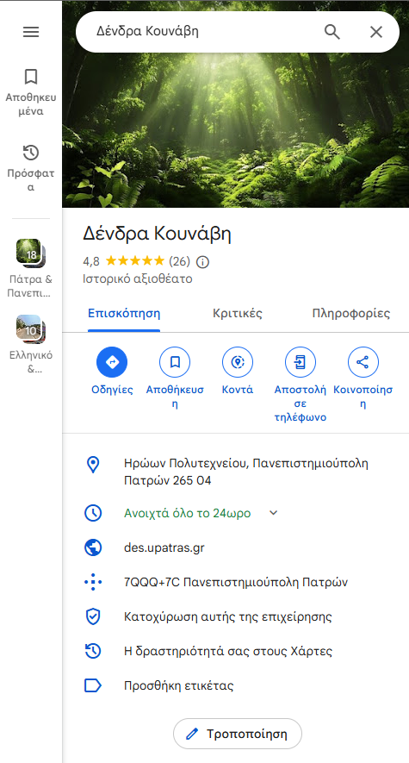
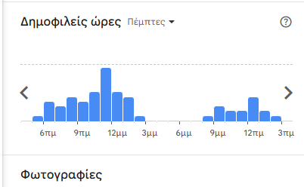
Web Scraping Popular Times From Google Maps

Slide 14
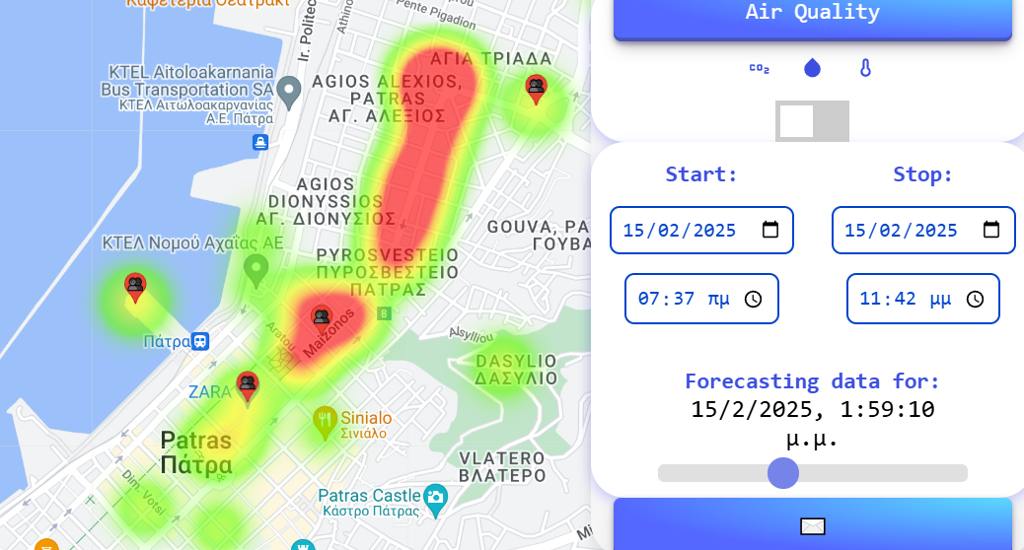
Crowd Estimations and Predictions
Crowd estimations are conducted for Access Point and Climate Sensor locations.
Using the number of connected users or the concentration of CO₂ an estimation is conducted for the number of people in the area.
Predictions for future time slots use current crowd estimations and curve data (according to the current and target date) in order to produce future heatmaps and graphs

Slide 15
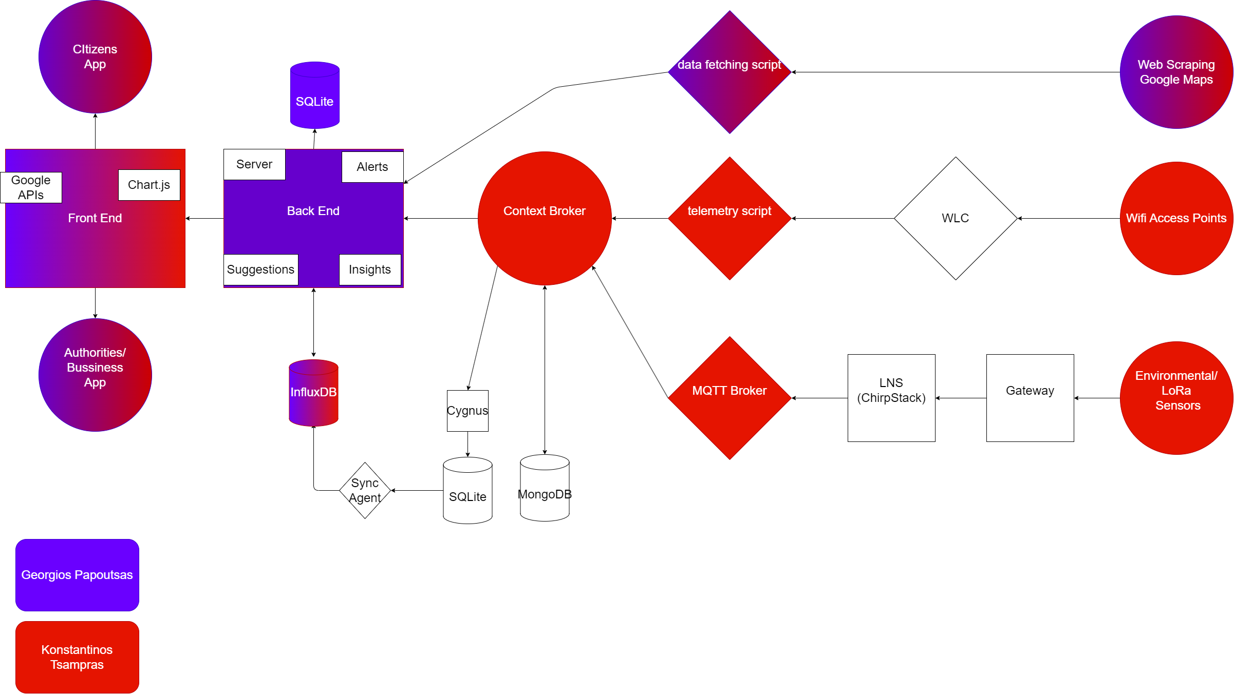
Final App Architecture

Slide 16
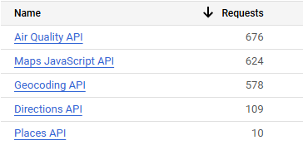
Technologies
Google APIs
Sensor Protocols: LoRa, SNMP
University Lab Infrastructure:
Context Broker
Back End:
Node.js
Front End:
Html, CSS, Handlebars
Databases:
MongoDB, Sqlite3, InfluxDB
Graphs
Chart.js
Smart Data Models:
For sensor data*
Design:
Figma
Web Scraping:
Selenium, BeatifulSoup
https://github.com/smart-data-models/dataModel.OCF/tree/master/Measurement
https://developers.google.com/maps

Slide 17
Difficulties Encountered and Technologies not in final build
Live Camera Feeds
AI model
Google Places API doesn’t provide crowd density data
Time Zone Inconsistency in Data(InfluxDB, JS Date)

Slide 18
VIDEO DEMO
VIDEO

Slide 19

Thank you for your time!

